Slide 1
Avocado Sale Price Estimation
By Sharvari Nagesh

Slide 2
Problem Statement
The Avocado data sheet is taken from INSAID git hub page. It captures the Average Avocado price with various parameters. It provides the data & year, total number of avocado sold and the individual type of Avocados sold, the different sizes of bags sold (Small, Large and extra large), avocado type like organic/Conventional.
Using the above data, we need to predict the price of an avocado

Slide 3
Selection of Algorithm
Here the problem is to predict avocado prices on a given day, given region, given type and given quantity. Avocado prices are a continuous number. So linear regression is used.

Slide 4
Understanding Columns in the Data
Date - The date of the observation
AveragePrice - the average price of a single avocado - target variable
type - conventional or organic
year - the year
Region - the city or region of the observation
Total Volume - Total number of avocados sold
4046 - Total number of avocados with PLU 4046 sold
4225 - Total number of avocados with PLU 4225 sold
4770 - Total number of avocados with PLU 4770 sold
Total Bags - Total number of bags sold
Small Bags - Total number of small bags sold
Large Bags - Total number of Large bags sold
XLarge Bags - Total number of extra large bags sold on the given day

Slide 5
Processing The Data
Since ‘Total Volume’ & ‘Total Bags’ are just the total of 4046, 4225, 4770 & Small/Large/XLarge Bags respectively. will calculate the percentage of these columns and drop the individual Total columns. This step is also helping in normalising the columns.
Since the region and type of avocados are text data and cannot be used in a linear regression algorithm, hot encoding is applied on them.
Date field is a text field, so Date field is converted from text field to ‘Date’ type
Data has some outliers at the top quartile. So removing 1.5% of data from the top quartile.

Slide 6
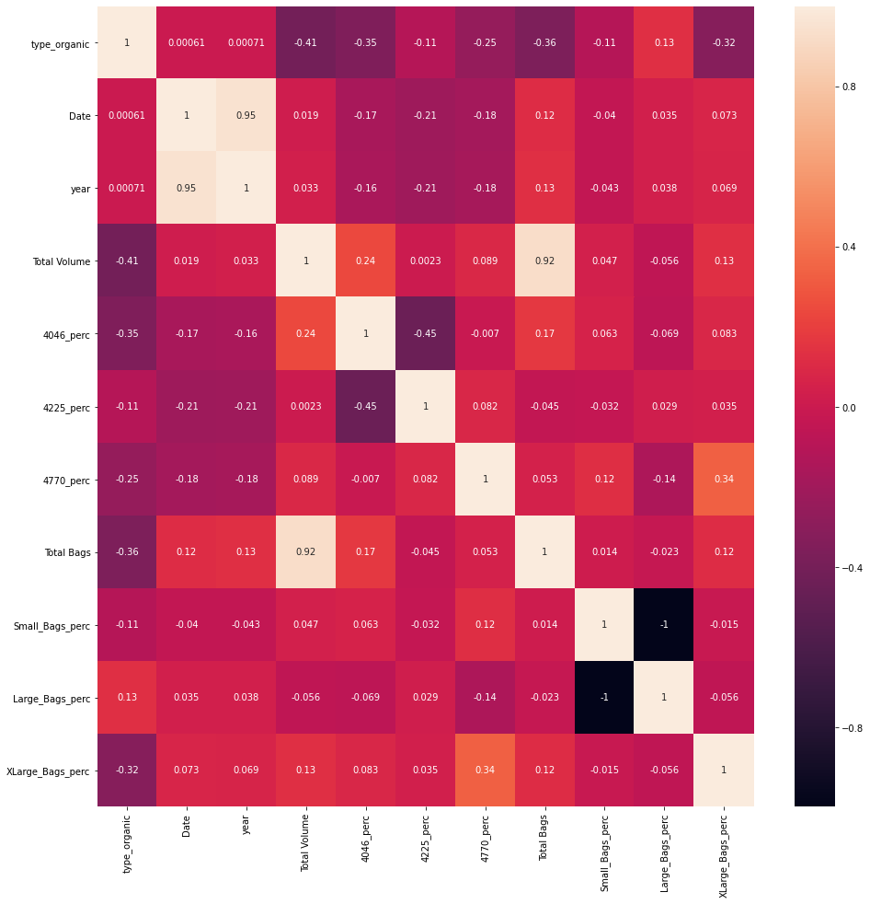
Correlation of columns
When correlation of the columns is checked, it is evident that date and year columns are highly correlated. So is, Total Bags and Total volumes. So dropping the columns Total Bags, Total Volume and Year columns.

Slide 7
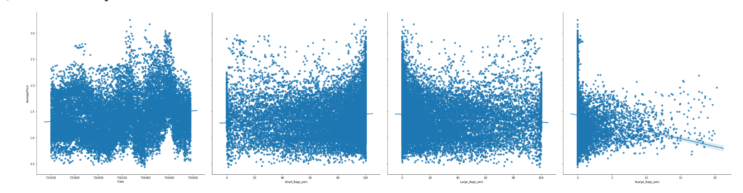
Relation of columns with the target variable

Slide 8
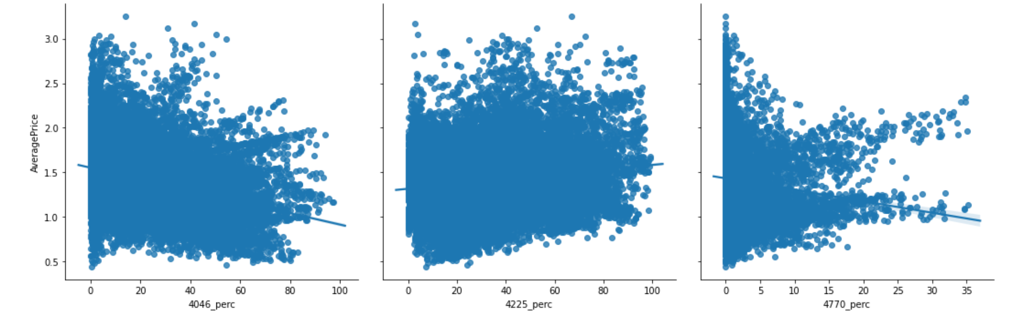
continued..
There is an inverse relation between average price and the volume of avocados. As the number of each variety increases, the average price decreases.

Slide 9
Applying linear Regression:
After dividing data into train and test at 80%-20%, linear regression algorithm is fitted and predicted.
from sklearn.linear_model import LinearRegression
linreg = LinearRegression()
linreg.fit(X_train, y_train)
y_train_pred = linreg.predict(X_train)
y_test_pred = linreg.predict(X_test)

Slide 10
Model evaluation
RMSE (Root Mean Squared Error):
RMSE calculates the error. Lower the RMSE value for train is better. In this model, we are getting a RMSE value of 0.251 for test data
R-Square :
R-square explains the measure of fit. higher the R-square value, the better. R-square value for test data is 0.6289
RMSE for training set is 0.24355916047750886
RMSE for testing set is 0.25115100487949105
R2 for training set is 0.414668560087753
R2 for testing set is 0.6289825651503589

